Slide 1

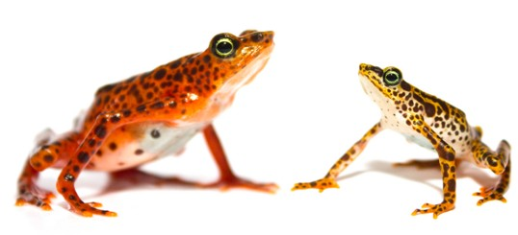
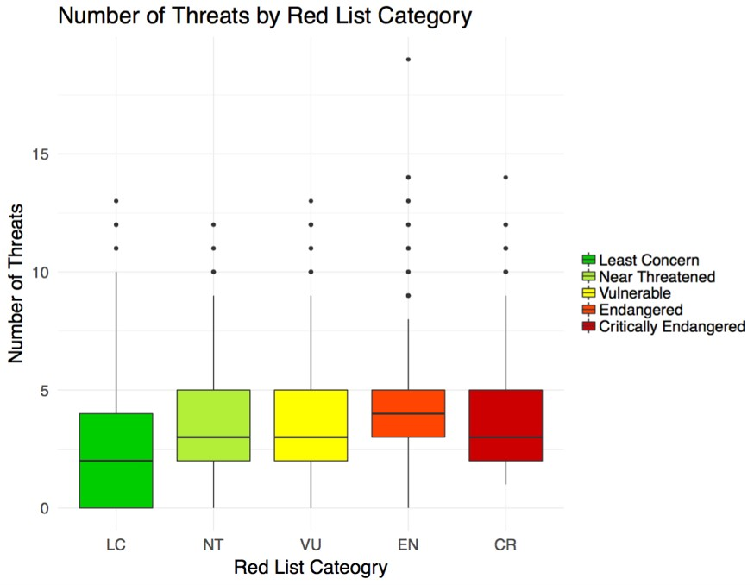
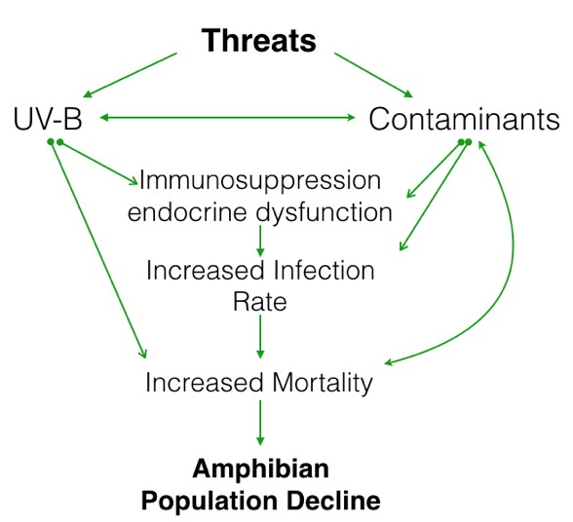
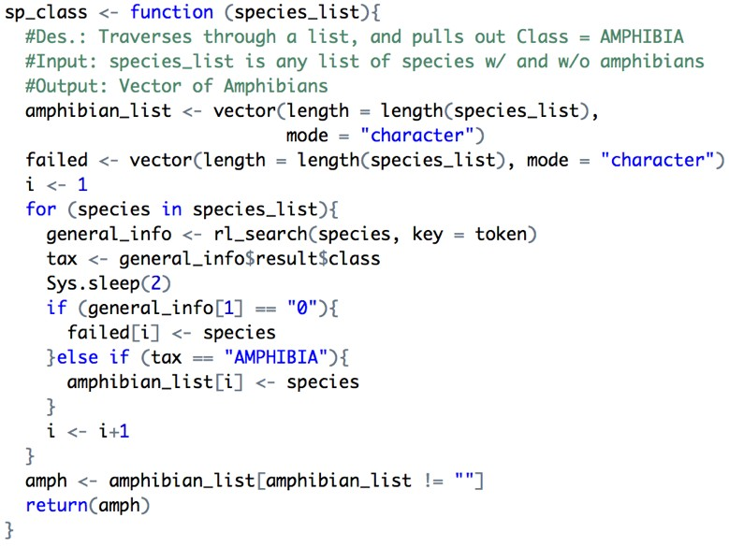
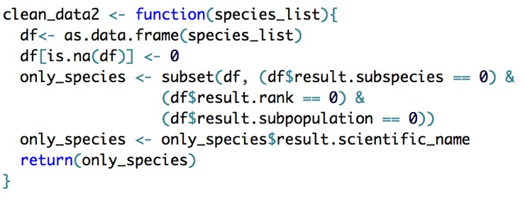
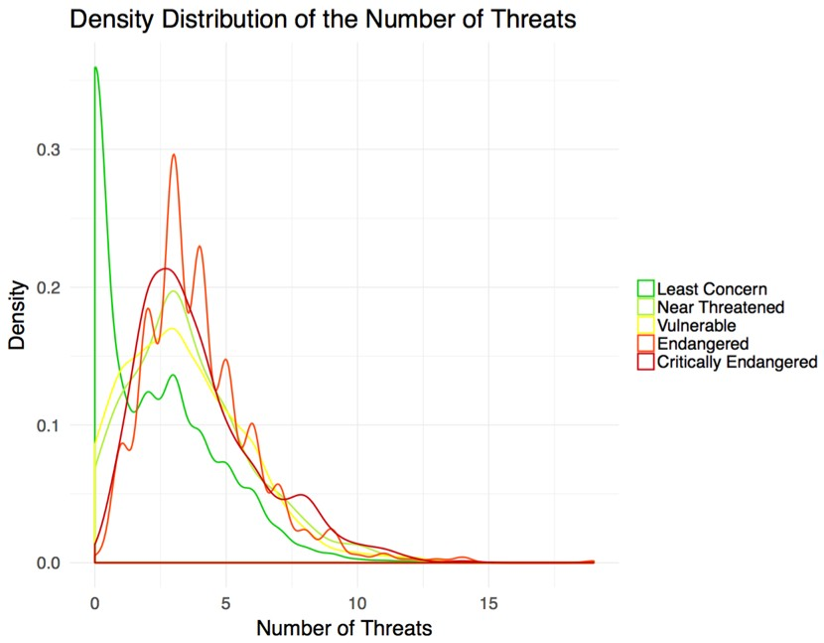
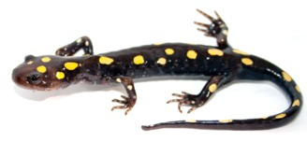
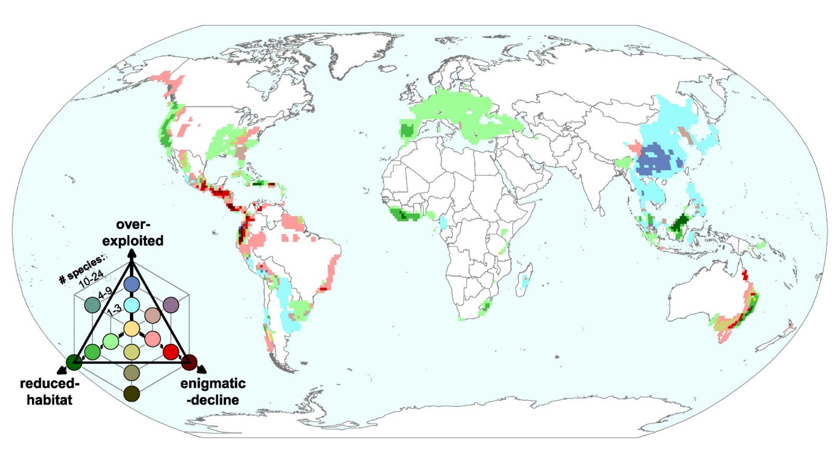
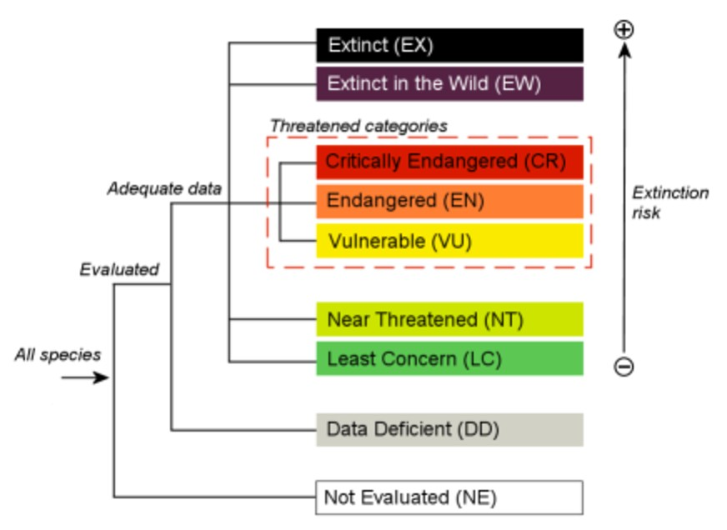
Racing Against Amphibian Extinction
Alexandra González*^{[1]} , Patricia Francis-Lyon^{[2]}, Naupaka Zimmerman^{[1]}, Jennifer Dever^{[1]}
[1] University of San Francisco, Department of Biology [2] University of San Francisco, Department of Health Informatics
Introduction
Methods
Preliminary Results
Atelopus balios (Gratwicke)
Amphibians rely on both terrestrial and aquatic environments throughout different stages of their lives, making them extremely vulnerable to threats in both locations.
The current level of amphibian extinction is four orders of magnitude greater than the background extinction rate (Alroy 2015).
The threats driving amphibian to extinction include: Habitat loss, climate change, pollution, invasive species, utilization, human disturbance, disease,
(1) Developing code to acquire and preprocess data from the IUCN database.
Figure 3: Function clean_data2 (above) takes a list of species, subspecies, subpopulation and rank and returns a vector of only species.
Figure 4: Function sp_class (left) takes a list of species and returns a vector of amphibians.
Figure 6: Number of Threats by Red List Category
fires, and persecution.
While the threats amphibians
face are well-known, threat interactions are complex with varying effects on a species-specific level (above).
Figure 1: Threat Interactions and Cascading Effects
Extinction Risk
Conducting exploratory data analysis in R:
Logistic Regressions between habitat type, threat type and Red List Category.
Chi Square Analyses between threatened (CR, EN, VU) and least concern (LC) amphibian species.
Multiple Correspondence Analysis considering habitat type, threat type, Red List Category and taxonomy.
Plotting the distribution of amphibian threats on a global map (as seen below).
The IUCN Red List of Threatened Species includes a comprehensive list of endangered amphibians and their threats.
This project aims to complete the following:
Analyze the IUCN amphibian data repository.
Uncover underlying trends between threat interactions and endangered species.
Create a web-interface that visualizes the distribution of amphibian threats and updates with the IUCN Red List.
Ambystoma maculatum (Gratewicke)
Figure 7: Density Distribution of the Number of Threats
IUCN Red List Data
Types of data collected from the IUCN Red List of Threatened Species: Habitat, Red List Category, Threat list, Taxonomy and species range
Number of Amphibians in each category:
Least Concern: 2485
Near Threatened: 399
Vulnerable: 670
Endangered: 852
Critically Endangered: 546
Extinct in the Wild: 2
Extinct: 33
Preliminary data analysis illustrates the median number of threats gradually increasing as the extinction risk increases.
The difference in the distributions between Least Concern amphibians and Critically Endangered amphibians is not as pronounced as the literature would suggest.
This indicates that the types of threats and their interactions are better indicators of the extinction risk than the number of threats.
IUCN amphibian data analysis along with the development of a dynamic threat map will enable researchers to visualize global trends and improve conservation initiatives.
Figure 5: Geographical Pattern of the Dominant Causes of Rapid Decline
Citations
The global amphibian threat map will be created to resemble the map above.
•
It will actively update with the IUCN database and filter through species Red List Category, threat type and habitat.
Alroy, John. "Current Extinction Rates of Reptiles and Amphibians." Proceedings of the National Academy of Sciences 112.42 (2015): Gratwicke, Brian. N.p., n.d. Web.
"IUCN Red List Categories." The IUCN Red List of Threatened Species. N.p., n.d. Web. 14 Apr. 2017.
Stuart, S. N. "Status and Trends of Amphibian Declines and Extinctions Worldwide." Science 306.5702 (2004): 1783-786. Web.
13003-3008. Web.
Figure 2: IUCN Red List Categories (IUCN)

